Slide 1
Tackling Data Curation in Three Generations
Mike Stonebraker
Notes:
Share (send as a follow-up).
+ Use cases.
3) You are new wave ETL, you do it once, you do it better. Not true. We
Continuous Improvement
Add a unified view/theme.

Slide 2
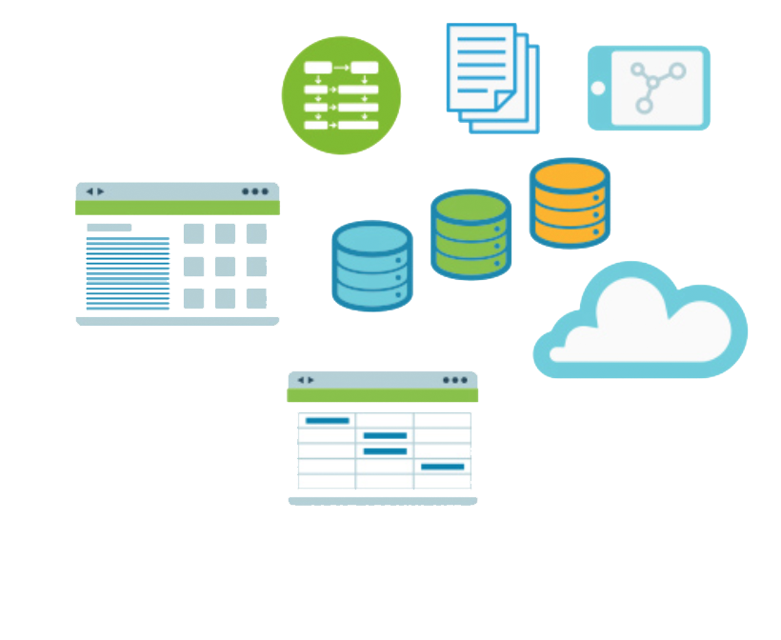

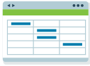
The Current State of Affairs
Silos everywhere….

Slide 3
By the Numbers
Number of data stores in a typical enterprise:
Number of data stores in a LARGE telco company:
5,000
10,000

Slide 4
Why so many data stores?
Enterprises are divided into business units, which are typically independent
With independent data stores
One large money center bank had hundreds
The last time I looked

Slide 5
Why so many data stores?
Enterprises buy other enterprises
With great regularity
Such acquired silos are difficult to remove
Customer contracts
Different mechanisms for treating employees, retirees ….

Slide 6
Not to Mention . . .
CFO’s budget is on a spreadsheet on his PC
Lots of Excel data
And there is public data from the web with business value
Weather, population, census tracts, ZIP codes …
Data.gov

Slide 7
And there is NO Global Data Model
Business units are independent
Different customer ids, product ids, …
Enterprises have tried to construct such models in the past…..
Multi-year project
Out-of-date on day 1 of the project, let alone on the proposed completion date
Standards are difficult
Remember how difficult it is to stamp out multiple DBMSs in an enterprise
Let alone Macs…

Slide 8
Lots of Silos is a Fact of Life
The sins of your predecessors
Your CEO is not in IT
May not have the COBOL source code
Politics
Data is power

Slide 9
Why Integrate Silos?
Cross selling
Combining procurement orders
To get better pricing
Social networking
People working on the same thing
Rollups/better information
How many employees do we have?
Etc….

Slide 10

Data Integration is a VERY Big Deal
Biggest problem facing many enterprises

Slide 11
Requirement: Data Curation
Ingest
The data source
Validate
Have to get rid of (or correct) garbage
Transform
E.g., Euros to dollar; Airport code to city name
Match Schemas
Your salary is my wages
Consolidate (dedup)(entity resolution)
E.g., Mike Stonebraker and Michael Stonebraker

Slide 12
Three Generations of Data Curation Products
Gen 1 (1990s): Traditional ETL
Gen 2 (2000s): ETL on steroids
Gen 3 (appearing now): Scalable Data Curation

Slide 13
Gen 1 (Early Data Warehouses)
Retail sector started integrating sales data into a data warehouse in the mid 1990’s
To make better stock decisions
Pet rocks are out, Barbie dolls are in
Tie up the Barbie doll factory with a big order
Send the pet rocks back or discount them up front
Warehouse paid for itself within 6 months with smarter buying decisions!

Slide 14
The Pile-On
Essentially all enterprises followed suit and built warehouses of customer-facing data
Serviced by so-called Extract-Transform-and-Load (ETL) tools

Slide 15
The Dark Side . . .
Average system was 2-3X over budget
and 2-3X late
Because of data integration headaches

Slide 16
Why is Data Integration Hard?
Bought $100K of widgets from IBM, Inc.
Bought 800K Euros of m-widgets from IBM, SA
Bought -9999 of *wids* from 500 Madison Ave., NY, NY 10022
Insufficient/incomplete meta-data: May not know that 800K is in Euros
Missing data: -9999 is a code for “I don’t know”
Dirty data: *wids* means what?

Slide 17
Why is Data Integration Hard?
Bought $100K of widgets from IBM, Inc.
Bought 800K Euros of m-widgets from IBM, SA
Bought -9999 of *wids* from 500 Madison Ave., NY, NY 10022
Disparate fields: Have to translate currencies to a common form
Entity resolution: Is IBM, SA the same as IBM, Inc.?
Entity resolution: Are m-widgets the same as widgets?

Slide 18
ETL Architecture
Local data Source(s)
Data Warehouse
Local Schema
ETL
Global Schema

Slide 19
Traditional ETL Wisdom
Human defines a global schema
Up front
Assign a programmer to each data source to
Understand it
Write local to global mapping (in a scripting language)
Write cleaning routine
Run the ETL
Scales to (maybe) 25 data sources
Twist my arm, and I will give you 50

Slide 20
Why?
Bigger global schema upfront is really hard
Too much manual heavy lifting
By a trained programmer
No automation

Slide 21
Gen 2 – Curation Tools Added to ETL
Deduplication systems
For addresses, names, …
Outlier detection for data cleaning
Standard domains for data cleaning
…
Augments the generation 1 architecture
Still only scales to 25 data sources!

Slide 22
Current Situation
Enterprises want to integrate more and more data sources
Milwaukee beer example
Weather data
Business analysts have an insatiable demand for “MORE”

Slide 23
Current Situation
Enterprises want to integrate more and more data sources
Big Pharma example
Has a traditional data warehouse of customer-facing data
Has ~10,000 scientists doing “wet” biology and chemistry
And writing results in an electronic lab notebook (think 10,000 spreadsheets)
No standard vocabulary (Is an ICU-50 the same as an ICE-50?)
No standard units and units may not even be recorded
No standard language (e.g., English)

Slide 24
Current Situation
Enterprises want to integrate more and more data sources
Web aggregator example
Currently integrating 80,000 web URLs
With “event” and “things to do” data
All the standard headaches
At scale 80,000

Slide 25
Current Situation
Traditional ETL won’t scale to these kinds of numbers
Too much manual effort
I.e., traditional ETL way too heavy-weight!!!
Also a personnel mismatch
Are widgets and m-widgets the same thing?
Only a business expert knows the answer
The ETL programmer certainly does not!!!!

Slide 26
Gen 3: Scalability
Must pick the low-hanging fruit automatically
Machine learning
Statistics
Rarely an upfront global schema
Must build it “bottom up”
Must involve human (non-programmer) experts to help with the cleaning
Tamr is an example of this 3rd generation!

Slide 27
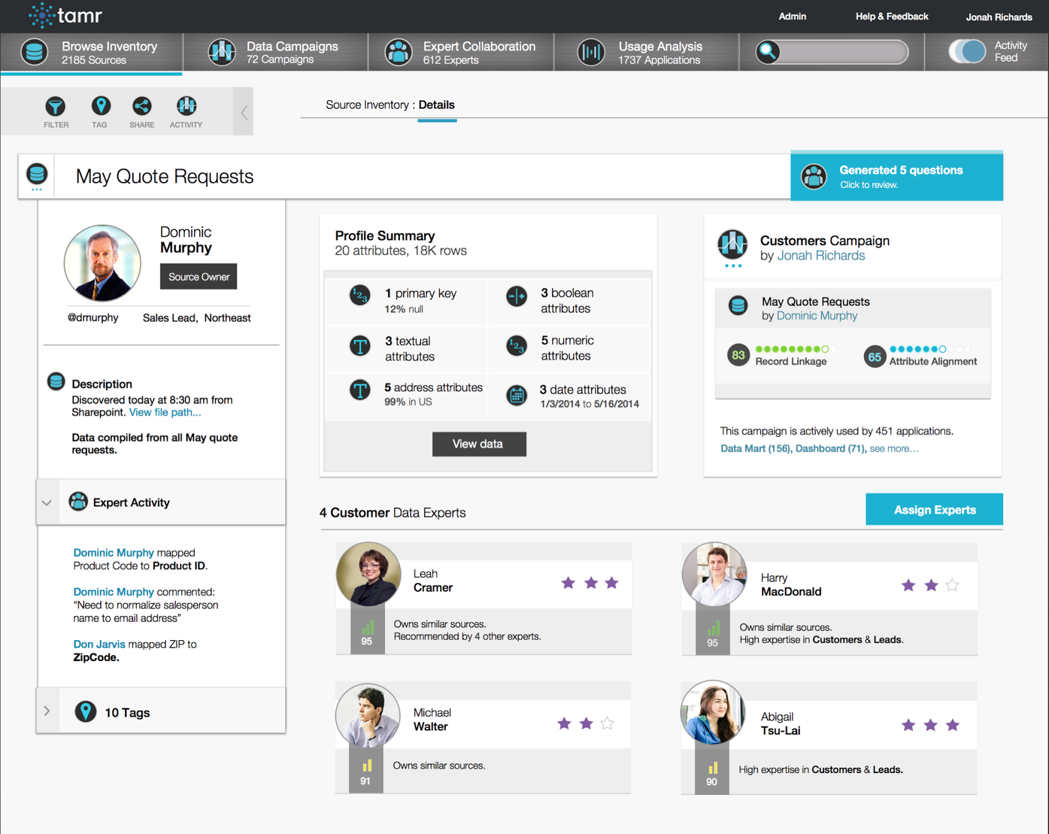
Tamr Architecture
Tamr
Console
Ingest
Schema
integration
Crowd
Sourcing
De-Duplication
Vis/XForm
Cleaning
RDBMS

Slide 28
Tamr – Schema Integration
Starts integrating data sources
Using synonyms, templates, and authoritative tables for help
1st couple of sources may require help from the human experts
System learns over time and gets better and better

Slide 29
Tamr – Schema Integration
Inner loop is a collection of “experts” (programs)
T-test on the data
Cosine similarity on attribute names
Cosine similarity on the data
Scores combined heuristically
After modest training, gets 90+% of the matching attributes automatically
In several domains
Cuts human cost dramatically!!!

Slide 30
Tamr – Expert Sourcing
Hierarchy of experts
With specializations
With algorithms to adjust the “expertness” of experts
And a marketplace to perform load balancing
Working well at scale!!!
Biggest problem: getting the experts to participate.

Slide 31
Tamr – Entity Consolidation
Can adjust the threshold for automatic acceptance
Cost-accuracy tradeoff
Even if a human checks everything (threshold is certainty), you still save money -- Tamr organizes the information and makes humans more productive

Slide 32
Tamr Customer Success Stories
A major consolidator of financial data
Entity consolidation and expert sourcing on a collection of internal and external sources
ROI relative to existing homebrew system
A major manufacturing conglomerate
Combine disparate ERP systems
ROI is better procurement

Slide 33
Tamr Customer Success Stories
A major bio-pharm company
Combining inputs from 2000 medical-diagnostic pieces of equipment by equipment type
Decision support – how is stuff used?
ROI is order-of-magnitude faster integration
A major car company
Customer data from multiple countries in Europe
ROI is better marketing across a continent
ROI is more effective sales engagement

Slide 34
Tamr Future
Text sources
Relationships
More adaptors for different data sources and sinks
Better algorithms
User-defined operations
For popular cleaning tools like Google Refine
Web transformation tool
Syntactic transformations (e.g., dates)
Semantic transformations (e.g., airport codes)

Slide 35
www.tamr.com Thank you!

